Slide 1
Intro to AI in Medicine
Lec 10: Practicalities of ML

Slide 2
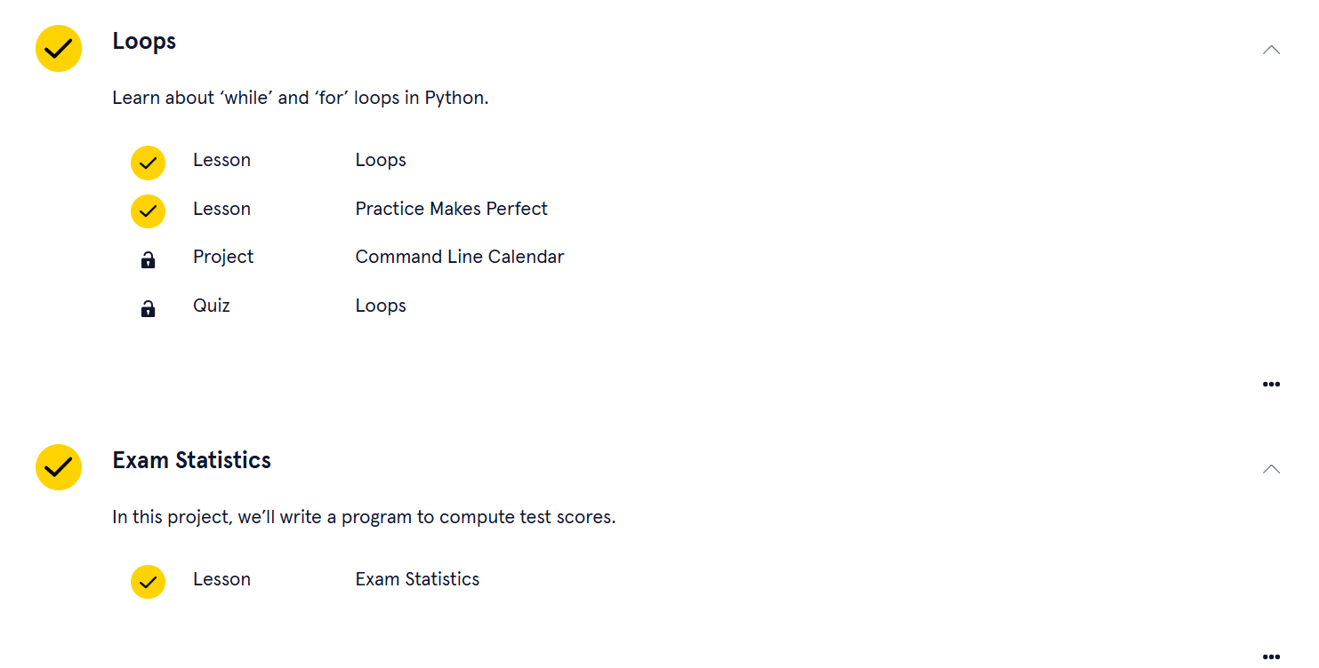

Slide 3
Last Time
Discussed the inner workings of LLMs
  Language embeddings
  Tokenization
  Training regime -> self-supervised multiclass classification
  Attention Block (which is inside the Transformer)
Real world ramifications of LLMs
  Environmental concerns
  Hallucinations and Bias (look to the data!)
Ways LLMs are innovating in medicine
  RAGs and document embeddings -> OpenEvidence
  Multimodality learning and foundation models
Notes:
Context embeddings

Slide 4
This time
Where the rubber meets the road: Infrastructure supporting AI/ML
Out of context learning

Slide 5
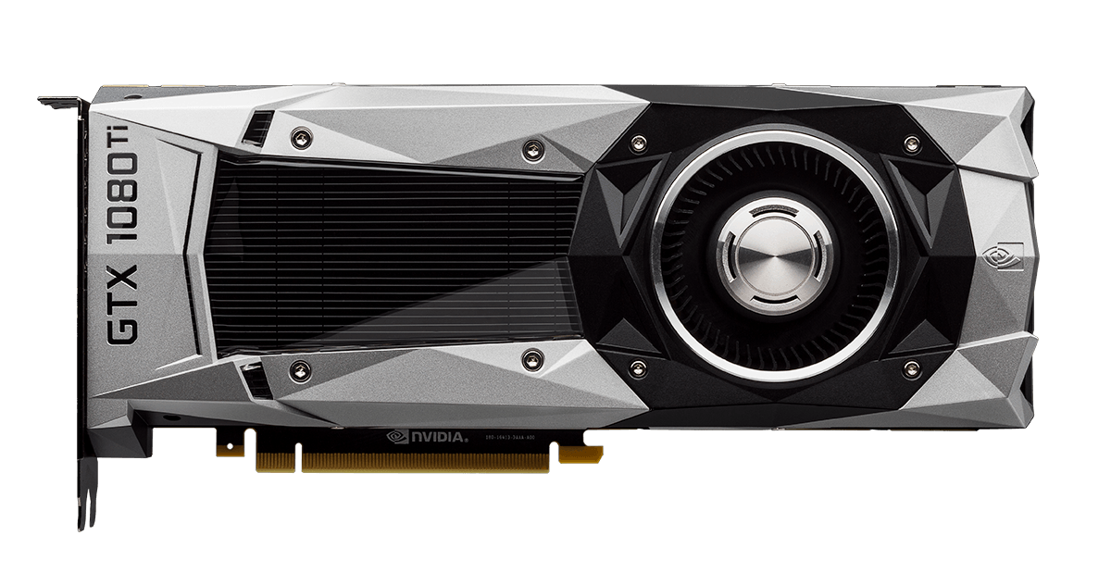
Notes:
What is this?
What was it used for before AI training
Gaming
Why is gaming so computationally demanding that you need a whole new piece of hardware?

Slide 6
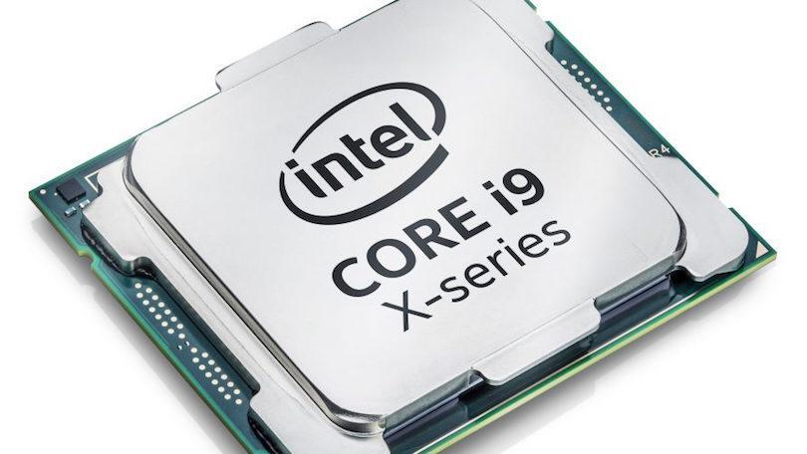
CPU vs GPU
CPU: Central Processing Unit
GPU: Graphics Processing Unit
Notes:
Each contain a number of cores that are able to do binary math

Slide 7
CPU vs GPU
Inside the CPU are “cores”
These cores are assigned operations individually as they come

Slide 8
CPU vs GPU
Cores
The scheduler assigns to cores that aren’t busy
Scheduler
1+1
Notes:
Let’s say our operation is 1+1, then we’ll assign there.

Slide 9
CPU vs GPU
Cores
What if all our cores are busy?
Then we have to wait
Not an issue if we have only a few operations at a time – even if complex
Scheduler
1+1
Notes:
Not an issue if we have a few operations at a time

Slide 10
CPU vs GPU
Cores
What if we have a bunch of simple operations?
It would be better if we had a bunch of cores – even if they were less powerful individually
What kind of operation packages a ton of simple multiplications and additions into one?
18*31
12*3
3*9
4*2
18*31
Scheduler
12*3
71*2
8*1
4*9
3*9
4*2
71*2
8*1
4*9
18*31
12*3
3*9
4*2
71*2
8*1
4*9
Notes:
Not an issue if we have a few operations at a time

Slide 11

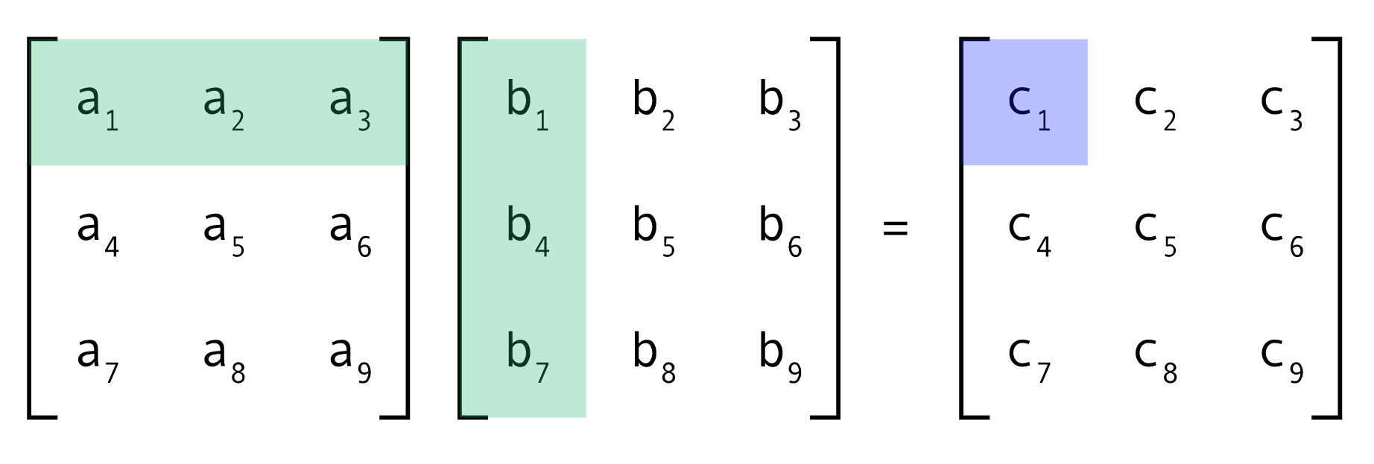

Matrices: Multiplication
A
B
C
a₁*b₁+ a₂*b₄+ a₃*b₇= c₁
Notes:
We really have 9 products in C, then
By doing this, you’ve applied the dot products in B to A in every possible combination.
Now, we can rejoin our story from last lecture.

Slide 12
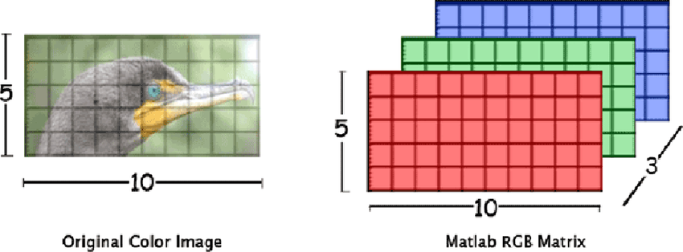
CPU vs GPU
Why were GPUs originally used for computer graphics?
Computer graphics are just another form of matrices!

Slide 13
CPU vs GPU
How GPU cores would look
18*31
12*3
3*9
4*2
18*31
Scheduler
12*3
71*2
8*1
4*9
3*9
4*2
71*2
8*1
4*9
18*31
12*3
3*9
4*2
71*2
8*1
4*9
Remember, each is weaker
Notes:
Not an issue if we have a few operations at a time

Slide 14
GPU Takeaways
Efficient for highly parallelized operations, such as matrix multiplication
  When networks don’t play nice with this (RNN), training can take a long time.
  Stacking layers as tensors instead of separate matrices is faster!
Even more specialized computers, called TPUs (tensor processing units) are available for ML specific applications
CPUs are good for operations which must happen one at a time

Slide 15
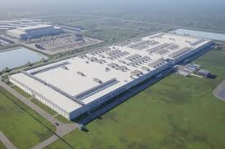
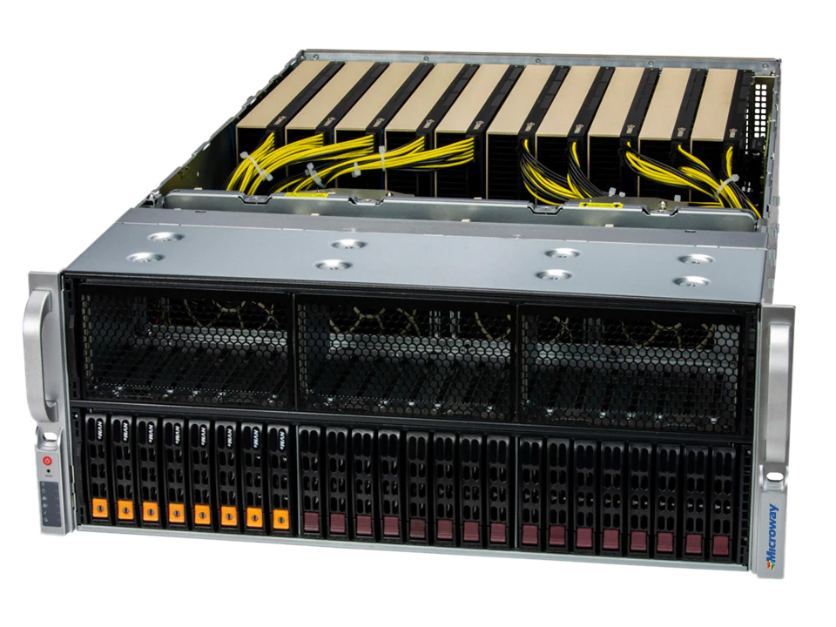
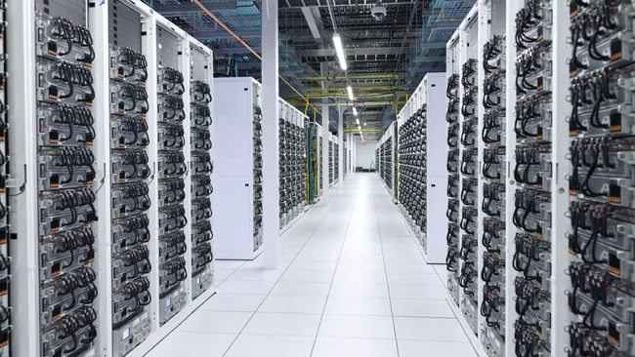
AI Data Centers

Slide 16


Hypothetical
What are Person A’s options for getting the GPUs to execute his idea?
Notes:
removed person*

Slide 17
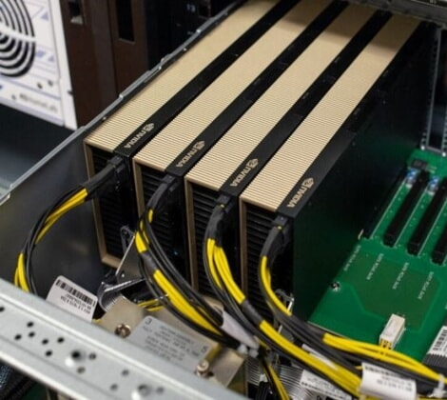
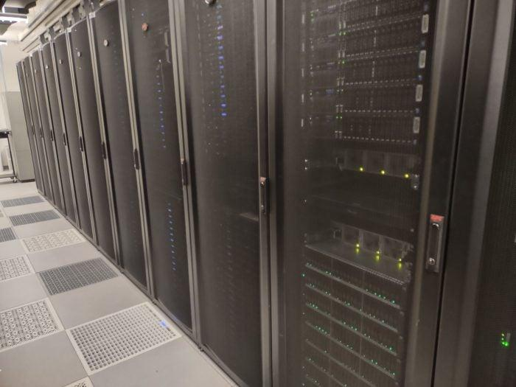

GPU Rack
Hospital GPU Cluster
Cloud Compute
Most secure
Customizable
Most expensive
Once you buy you’re stuck
Secure enough
Less expensive
Not @ all hospitals
You get what you get
Subject to availability
Lowest barrier to entry
Plenty of options
Scales well
Must meet strict security protocols

Slide 18
What Happened Next?
He persuades his hospital admin to buy a few GPUs and build a small server cluster
His team trains a model to predict if a kid will develop severe allergies in their first 5 years of life based on maternal/child data
He gets the following train/test loss
Notes:
Matthew establishes a GPU

Slide 19
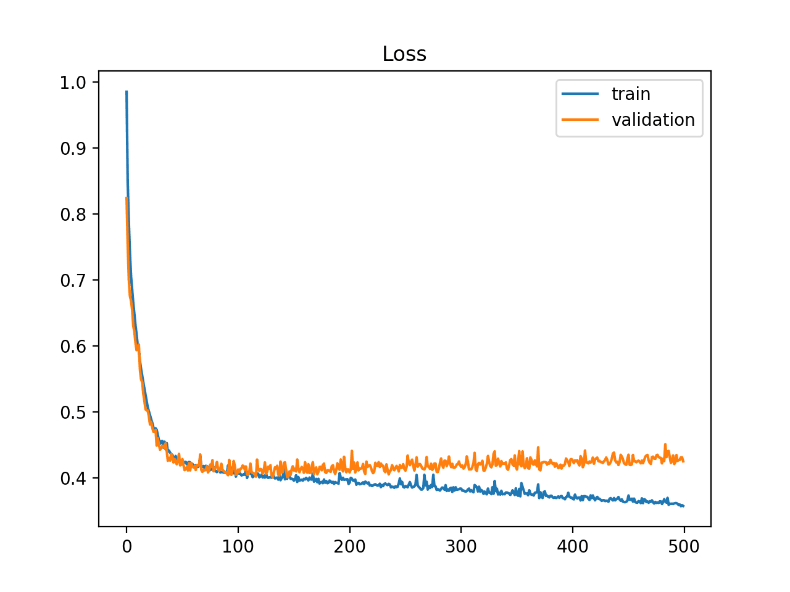
Preliminary Results
Any remarks about results?
Notes:
Overfit:
Options:
Scale back the model
Get more train data

Slide 20

A Collaboration
Notes:
Hospital H has some more training data they can share
What are their options for sharing this HIPAA protected data?

Slide 21
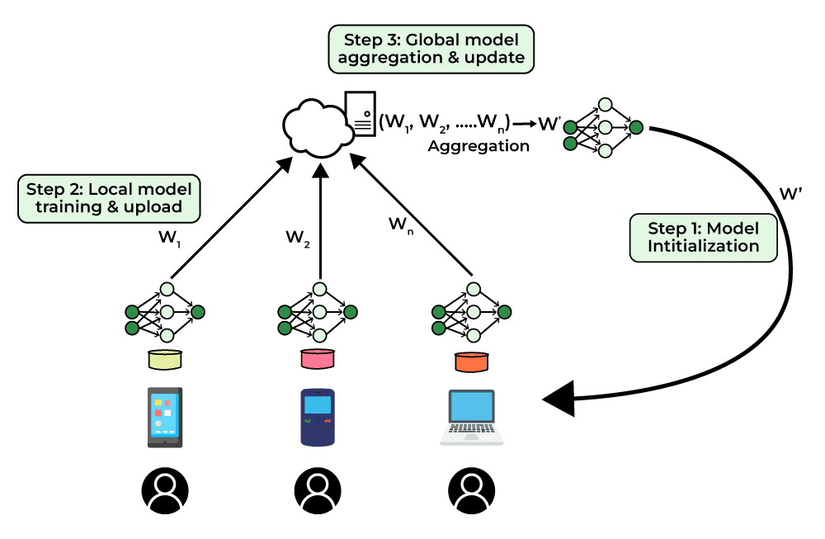
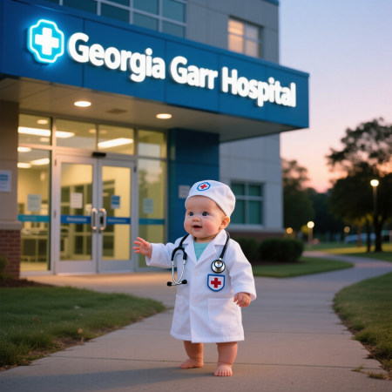
Federated Learning

Slide 22
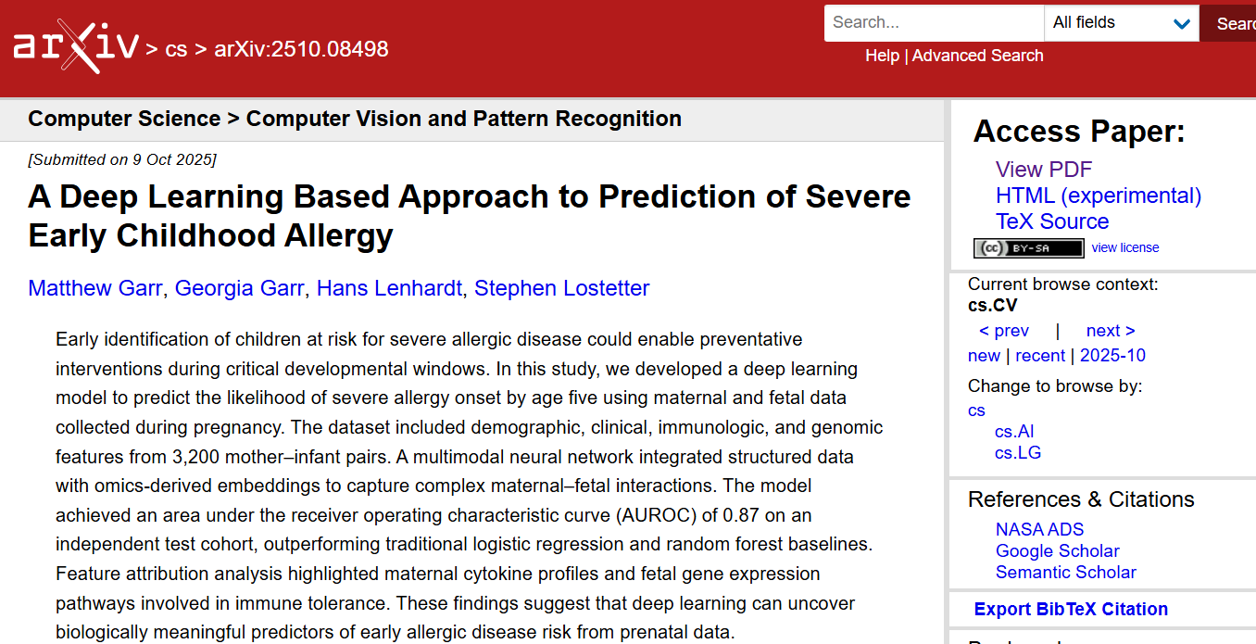
Continuing Our Story…
He decides to publish his paper
Since it’s the CS world, his results can be easily verified
  Peer review less important
  Publish preprint

Slide 23
Healthy Skepticism
He doesn’t believe the results and wants to verify before treating his patients
Luckily, his team shared the model weights online

Slide 24
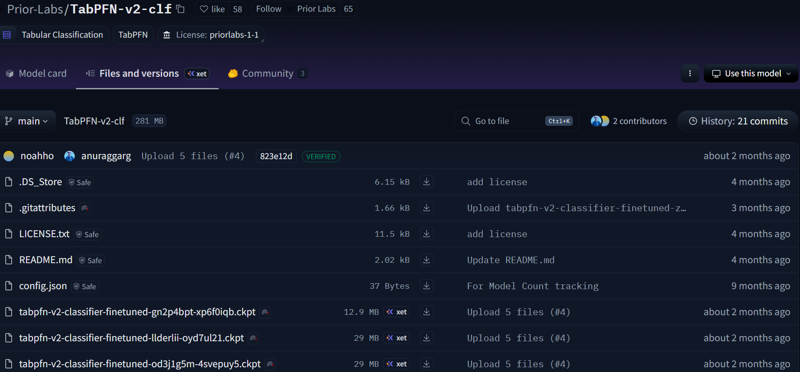
Downloading Model Weights
Notes:
Readme.md -> markdown file where you can read more about the project
Model weights saved under .ckpt .safetensors files

Slide 25
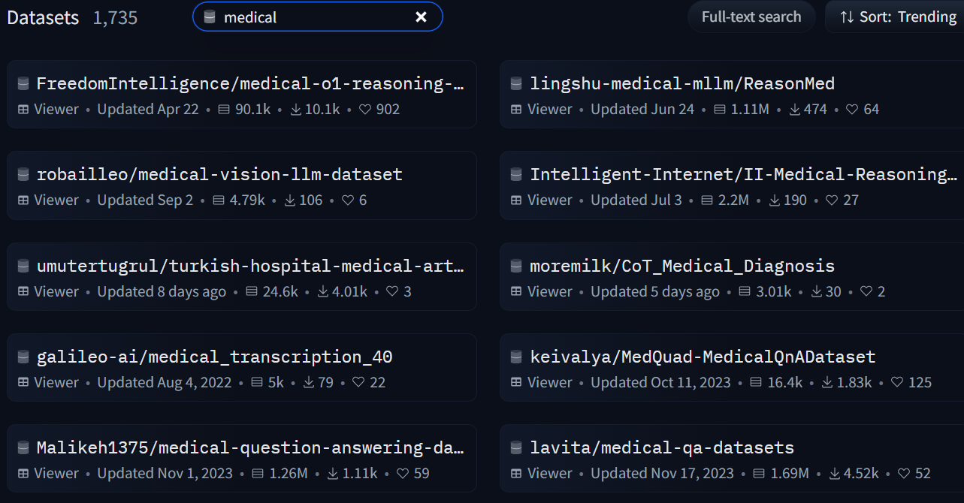
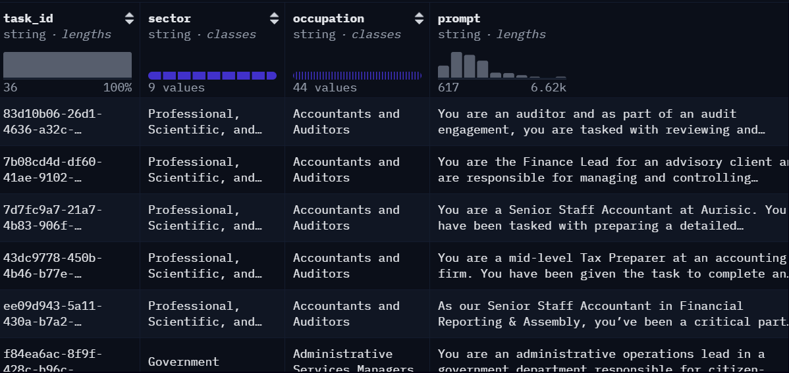
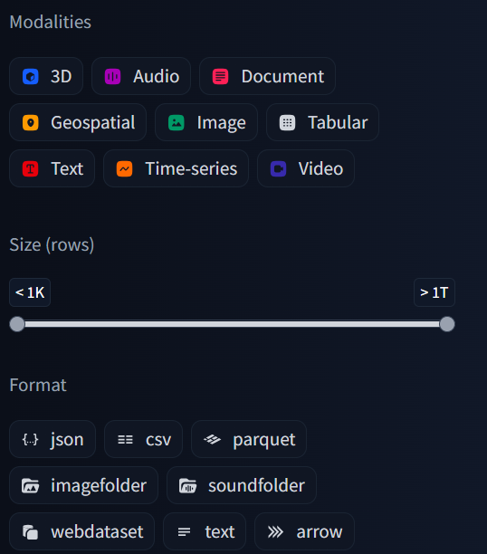
Datasets

Slide 26
Hypothesis Confirmed
He downloads the model weights and is able to replicate his results
Now he has a new clinical question: can the same input predict cardiovascular dysfunction in children

Slide 27
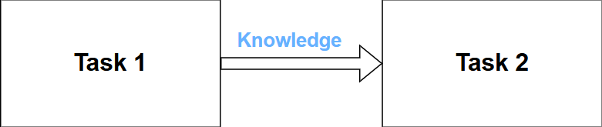
Pretraining & Transfer Learning
Instead of initializing weights randomly, take them from another task and train a new model
Any info extracted in hidden layers by original model can be tweaked with GD/Backprop updates
Pretraining: Training on a much larger, more accessible dataset before applying transfer learning on a smaller, targeted dataset

Slide 28
Few-Shot Learning
Used in cases where labelled data is scarce
  Rare disease
  Image segmentation
N-way, K-shot learning
  N = number of classes
  K = number of training examples
  So if 3 way 2 shot, three classes with 2 labelled examples each

Slide 29
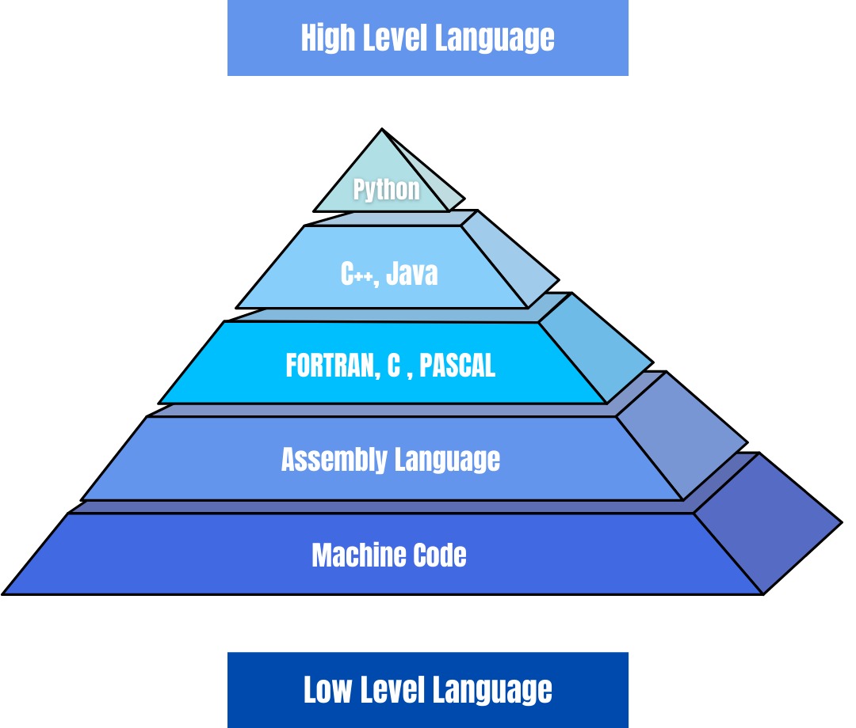
CS Stuff: Programming Languages
Close to how humans speak
Over time, programming has become “abstracted” or closer to how humans speak
Under the hood is code to translate between levels
Code closer to how computers speak requires less translation and therefore runs faster
All AI coding is done in Python
Close to how computers speak
Notes:
Machine code = binary = 101001001

Slide 30

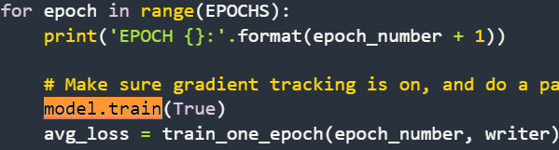
Machine Learning Python Packages
Combines multiple operations together and runs them in low level language to speed up AI
Not relevant for medical practice but good to know

Slide 31
Building a team
Clinician: identify clinical pain point or question
Data engineer: source and clean data
Data scientist: perform analysis on data, including running models
Software engineer: build consistent applications that house models
Clinical Ethicist: Act as consultant regarding bias/safety of model

Slide 32
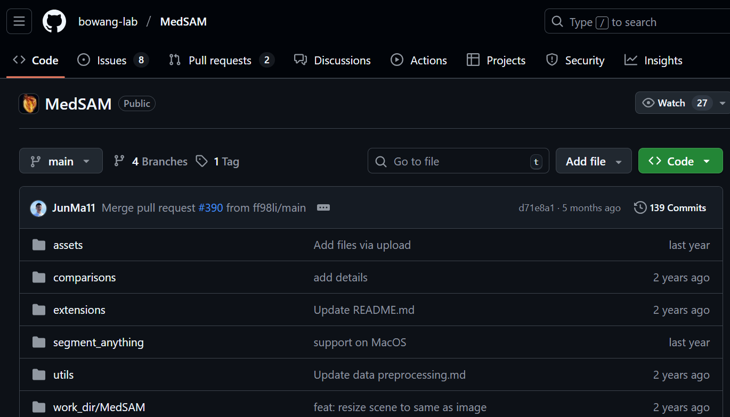
The Final Product
The whole team works together with their software engineers to build & package a program for others to use

Slide 33
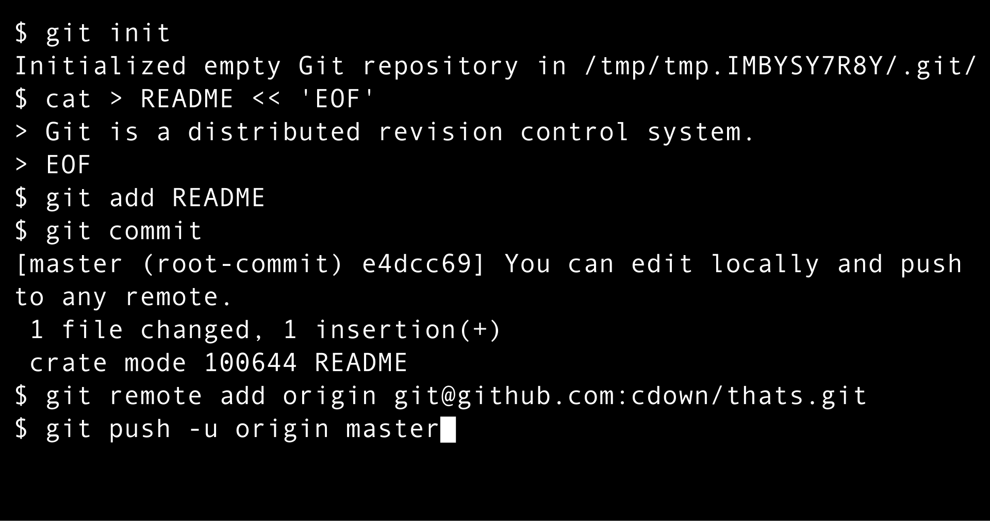
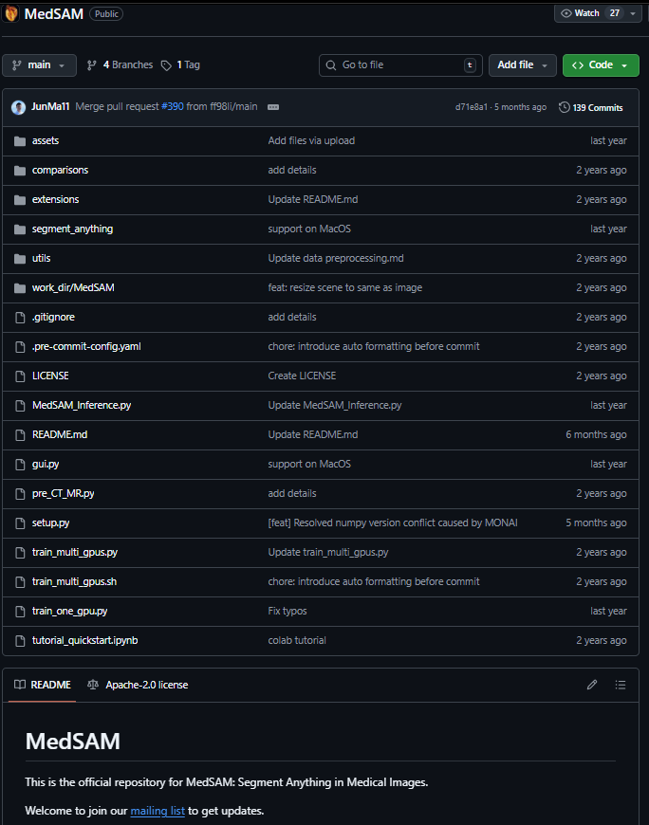
Git & Github
Git: version control software so many engineers can work on software independently and later sync
Github: Hosting site for these versions
Github contains lots of open source coding projects which can be pulled and repurposed by your engineers

Slide 34
A word on regular algorithms
AI Algorithms | Regular Algorithms
Have randomness involved (can get caught in local minimum) Stochastic | Always find same answer, every time (usually) Deterministic
Take in an input and output and find an algorithm mapping them | Takes in an input and algorithm and returns an output
Algorithm returned is always an approximation | Algorithm usually is perfectly precise
Advanced techniques needed to explain decision making | Choices made completely explainable

Slide 35
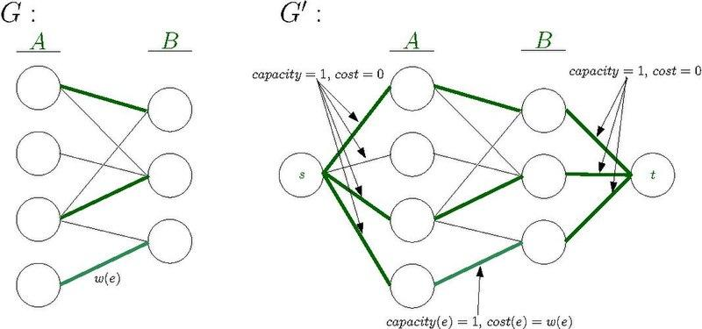
UNC SOM Campus Match

Slide 36
Next time…
Discussing challenges with rolling out AI in clinical contexts

Slide 37
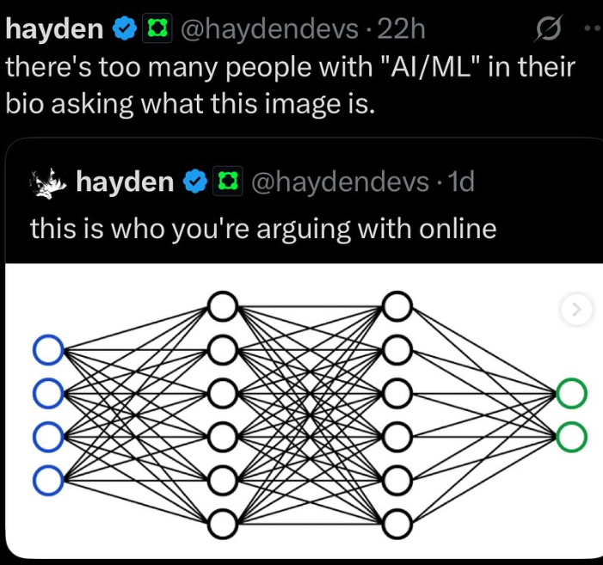
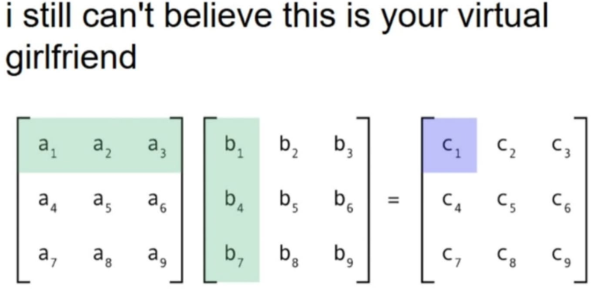
Thanks!

